Slide 1
ENGLISH FOR EFFECTIVE COMMUNICATION
20UCN2LE2
POWER OF PRAYER
BY
DR.A.P.J.ABDUL KALAM
PREPARED BY,
K.S.MYMOONA PARVEEN
ASSISTANT PROFESSOR
DEPARTMENT OF ENGLISH
JAMAL MOHAMED COLLEGE

Slide 2
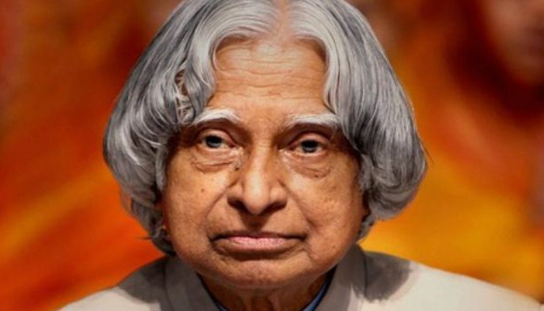
This Photo by Unknown Author is licensed under CC BY

Slide 3
THE POWER OF PRAYER
- Dr. A.P.J. ABDUL KALAM
ABOUT THE AUTHOR:
Dr. A.P.J. Abdul Kalam (1931-2015), the former President of India and a distinguished scientist was born on 15th October 1931 at Rameswaram in Tamilnadu.
Kalam specialized in Aeronautical Engineering from Madras Institute of Technology (IIT, Madras).
D.R. A.P.J. Abdul Kalam was a great writer and great thinker.
He has learnt the values and importance of life from his parents.
He has got most of the inborn traits from his mother.

Slide 4
KALAM’S FATHER
Important qualities of Kalam’s Father:
1.Pious
2.Helping tendency
3.Healer
4.Good father
5.Role Model for Kalam

Slide 5
Kalam’s Birth and Parentage
Abdul Kalam was born in the island town of Rameswaram.
He was born into a middle class family.
His father, Jainulabdeen was neither very rich nor well educated.
But he was a wise and generous man.
He was a true spiritual human being. His mother Ashiamma was a kind and pious woman.

Slide 6
CONT…..
One of her forefathers bestowed the title “Bahadur” by the British Government.
The influence of the good-natured parents made the child Kalam to become a great lovable
personality in life.
Kalam’s family lived in a large pucca house which is the ancestral one.
It is located on Mosque Street in Rameswaram

Slide 7
The Importance of Prayer
Kalam’s father influenced the boy Kalam on spiritual matters. Even when Kalam chanted
prayers with his father in the mosque, he did not have the faintest idea of the meaning of the
Arabic prayers. But he was convinced that they reached God. Kalam used to ask his father
about the relevance of prayer. His father told him that there was nothing mysterious about
prayer. According to him prayer made possible a communion of spirit between people. Prayer
transcends one’s body and becomes a part of the cosmos. There is no division of wealth, age,
caste or creed. Kalam’s father had a skill of explaining complex spiritual concepts in easy,
down-to-earth Tamil. He firmly said that every human being “is a specific element within the
whole of the manifest divine being”. Hence, Kalam understands that every individual is born with
a divine power in him.

Slide 8
CONCLUSION:
Kalam in his Power of prayer expresses his childhood memories.He feels grateful to his parents,teachers and relatives. He praises and thanks his parents for the formation of his character. He sincerely glorifies God, for having chosen him to achieve great tasks. The chapter reflects Kalam’s simplicity and submissiveness.

